Slide 1
Limiting reactants

Slide 2
Products & reactants
In a chemical reaction, there are starting chemicals (reactants) and the resulting chemicals that are formed in the reaction (products)
Reactants typically appear on the left, while products appear on the right, with the reaction arrow in between
There are a number of different types of reactions which can involve one or more reactant to create one or more products
While these chemical reactions are exact down to the molecule, in real world applications dealing with mass, volume and concentration, there is bound to be more of one thing than is needed
If there is not enough of one reactant to fully react with the other, this would be the Limiting Reactant

Slide 3
Balanced Chemical reactions
$${CaCl}_{2(aq)}+{2NaOH}_{(aq)}⟹{Ca(OH)}_{2(s)}+{2NaCl}_{(aq)}$$
In the reaction above, exactly one mole of CaCl₂ will react with exactly 2 mols of NaOH to form one mole of the Ca(OH)_{2(s)} product and exactly 2 moles of NaCl_{(aq)}
Using the Molecular Weights, this corresponds to exactly 110.98g of CaCl₂ reacting with exactly 79.99g of NaOH to form exactly 74.09g Ca(OH)₂ and 116.88g NaCl
What happens if in a lab, these exact amounts of reactant are not precisely measured? One reactant will be not enough (Limiting Reactant) and one will be too much.
$${110.98g CaCl}_{2(aq)}+{79.99g NaOH}_{(aq)}⟹{74.09g Ca(OH)}_{2(s)}+{116.88g NaCl}_{(aq)}$$

Slide 4


Limiting reactants – grams to moles
$${CaCl}_{2(aq)}+{2NaOH}_{(aq)}⟹{Ca(OH)}_{2(s)}+{2NaCl}_{(aq)}$$
What if only 50.00g of both CaCl₂ and NaOH was used in the reaction?
How would this affect the reaction and the products?
$${50.00g CaCl}_{2(aq)}+{50.00g NaOH}_{(aq)}⟹{?g Ca(OH)}_{2(s)}+{ ?g NaCl}_{(aq)}$$
In nearly every case, the first step, if given an amount in grams is to convert to moles using the molecular weight
$$50.00g {CaCl}_{2}×\frac{1mol}{110.98g}=0.4505mol {CaCl}_{2}$$
$$50.00g NaOH×\frac{1mol}{39.995g}=1.250mol NaOH$$

Slide 5



Limiting reactant – molarity to moles
$${CaCl}_{2(aq)}+{2NaOH}_{(aq)}⟹{Ca(OH)}_{2(s)}+{2NaCl}_{(aq)}$$
Most reactions in general chemistry are preformed as solutions, where there is a concentration of reactant dissolve in water.
In keeping with the same example, what if 250.0mL of a 1.802M CaCl2 solution was combined with 500.0mL of a 2.500M NaOH solution, how many moles are there?
$$M= \frac{mols}{L}$$
Calcium Chloride
Sodium Hydroxide
$$1.802M= \frac{mols}{0.250L}=0.4505mols {CaCl}_{2}$$
$$2.500M= \frac{mols}{0.500L}=1.250 mols NaOH$$

Slide 6
Limiting reactants – reaction stoichiometry
$${CaCl}_{2(aq)}+{2NaOH}_{(aq)}⟹{Ca(OH)}_{2(s)}+{2NaCl}_{(aq)}$$
With the moles of each reactant determined, you can see how much solid product can be formed, by multiplying by the reaction stoichiometry
In this example reaction, for every one mole of CaCl₂ that reacts, there will be one mole of Ca(OH)₂ produced
Likewise, for every two moles of NaOH, there will be only one mole of Ca(OH)₂ produced
$$0.4505mol {CaCl}_{2}×\frac{1mol {Ca(OH)}_{2}}{{1mol CaCl}_{2}}=0.4505mol {Ca(OH)}_{2}$$
$$1.250mol NaOH×=\frac{1mol {Ca(OH)}_{2}}{2mol NaOH}=0.6250mol {Ca(OH)}_{2}$$

Slide 7
Limiting reactant
$${CaCl}_{2(aq)}+{2NaOH}_{(aq)}⟹{Ca(OH)}_{2(s)}+{2NaCl}_{(aq)}$$
An amount of 50.00g CaCl₂ will produce 0.4505mols of Ca(OH)_{2(s)} product
An amount of 50.00g NaOH will produce 0.6250mols of Ca(OH)_{2(s)} product
From these amounts, it is shown that the 50.00g of CaCl₂ will produce less product, therefore in this example, the CaCl₂ is the limiting reactant
With the limiting reactant determined, the following quantities of a reaction can be figured out
How much product will be formed (Theoretical Yield)
How much excess reactant remains
How much more reactant can be added

Slide 8

Limiting reactant - scenarios
$${CaCl}_{2(aq)}+{2NaOH}_{(aq)}⟹{Ca(OH)}_{2(s)}+{2NaCl}_{(aq)}$$
How much excess reactant is remaining?
How much product is formed?
Just as with determining the amount of product, the stoichiometry from the limiting reactant can be used to determine the amounts of each reactant or product
To determine how much product is formed, you find the amount that would be generated by the limiting reactant.
CaCl₂ and NaOH react in a 1:2 ratio
$$0.4505mol {CaCl}_{2}×\frac{2mol NaOH}{{1mol CaCl}_{2}}=0.9010mol NaOH reacted$$
In this example, 0.4505mol of Ca(OH)_{2(s)} is formed
$$0.9010mol NaOH×\frac{39.995g}{1mol}=36.04g NaOH reacted$$
Using the Molecular Mass of Ca(OH)₂, the actual amount of product can be determined
$$50.00g −36.04g=13.96g remaining$$
$$1.250mol −0.9010mol=0.3490mol remaining$$
How much more limiting reactant is needed?
$$0.3490mol NaOH×\frac{1mol {CaCl}_{2}}{2mol NaOH}=0.1745mol {CaCl}_{2} needed$$
$$0.4505mol {Ca(OH)}_{2}×\frac{74.09g}{1mol}=33.38g {Ca(OH)}_{2}$$
$$0.1745mol {CaCl}_{2}×\frac{110.98g}{1mol}=19.37g {CaCl}_{2} needed$$

Slide 9
Reactants vs. spectators
The first reaction below refers to the full chemical salts used to prepare solutions
The CaCl₂, NaOH and NaCl are all aqueous, indicating they have fully dissolved in water, and dissociated into their ions
The Ca(OH)₂ is a solid, therefore it did not dissociate
Reactants
$${CaCl}_{2(aq)}+{2NaOH}_{(aq)}⟹{Ca(OH)}_{2(s)}+{2NaCl}_{(aq)}$$
Spectators
$${Ca}_{(aq)}^{2+}+{2Cl}_{(aq)}^{−}+{2Na}_{(aq)}^{+}+{2OH}_{(aq)}^{−}⟹{Ca(OH)}_{2(s)}+{2Na}_{(aq)}^{+}+{2Cl}_{(aq)}^{−}$$
Looking at the Full Ionic reaction, there are sodium ions and chloride ions present on both sides of the equation
These were not involved in the reaction, as their form did not change
The Na⁺ and Cl⁻ are Spectators in the reaction
The Ca²⁺ and OH⁻ are the reactants, because they no longer exist in the products as separate ions
Many times, Ions displaying a charge do not have phases, as it is assumed to be aqueous. However, it is good practice to always label the phase, as there are instances where Ions would not be aqueous (ions can exist in the gas phase or in solvents other than water)

Slide 10
Limiting reactants - experiment

Slide 11
Part a – limiting reactant simulation
Direct Link: https://phet.colorado.edu/sims/html/reactants-products-and-leftovers/latest/reactants-products-and-leftovers_en.html
Complete the Limiting Reactant Game (Level 3) and attach a screen shot of the final score to your report
For each of the 5 reactions, record the following
Balanced chemical reaction
Reactants and number of moles provided in simulation
Final products (including leftovers) and number of moles
For each compound (reactants and products), convert the moles into grams

Slide 12

Adding up molecules
The moles of each compound can be multiplied by its molecular weight to give the mass of each material
Reactants
Products
Compound | Moles | Mass | Compound | Moles | Mass
NH₃ | 4 | 68.136g | N₂ | 5 | 140.1g
NO | 8 | 240.08g | H₂O | 6 | 108.1g
 |  |  | NH₃ | 0 | 0.00g
 |  |  | NO | 2 | 60.02g
As a check, to see if everything is correct, add the total mass on both sides. Due to conservation of mass, every atom and mole is accounted for. The total amount of reactant mass (including extras) will equal the total amount of product mass (including leftovers). In this example, both sides of the equation have a mass of 308.2g
When the situation is balanced, you can add the total number of moles reactant and moles product

Slide 13
Part b – video reaction overview
This experiment involves interpreting the results of two precipitation reactions based on an unknown
In each reaction, you will determine, through observations, what is the Limiting Reactant
The first reaction is a precipitation reaction with two solutions
The identity of the solutions is given in the unknown file.
The reaction will form a solid precipitate
The product mixture is poured through filter paper and the filtrate that passes through is collected
To two separate portions of the filtrate, additional reactant is added
The second reaction is a reaction between Calcium Chloride and Sodium Hydroxide
The identity of the limiting reactant is determined using the same interpretation as Reaction #1
The specific solution concentrations are given in the unknown file
Using the limiting reactant identity & the concentrations, you will determine the mass of product formed
The solubility of the product will also be taken into account.

Slide 14
Precipitation reactions
A precipitation reaction is a class of reactions where a solid will form when two liquid solutions are combined
These reactions are driven primarily by the solubility of the product
If the total theoretical mass of product is below the solubility limit, there will be no reaction (the solid that would form, stays dissolved)
If the total theoretical mass of product is above the solubility limit, there will be a reaction
The actual amount of solid that precipitates would be the total theoretical mass, minus the amount that could be dissolved (solubility)

Slide 15
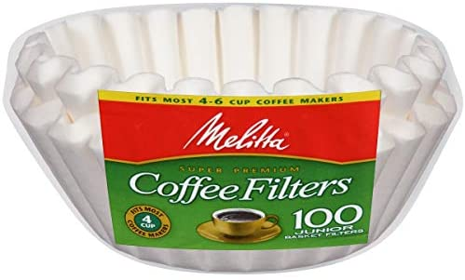
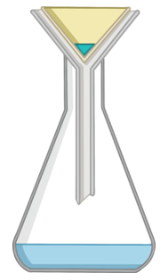
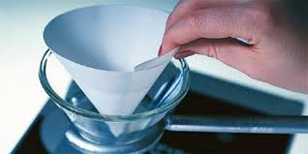
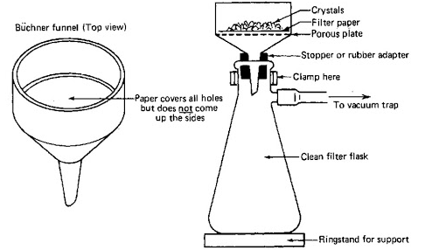
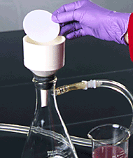
Filter paper
To separate out the product, filter paper is used in the lab
Filter paper is typically found as circles
These circles are folded in half, and then folded in half again to appear as a ¼ circle
These ¼ circles can open and appear as its own paper funnel, which is placed in your normal funnel.
The entire mixture (solid and liquid) is poured into a funnel containing a piece of filter paper
The liquid that passes through the filter paper is referred to as the Filtrate

Slide 16

Interpreting observations
$${CaCl}_{2(aq)}+{2NaOH}_{(aq)}⟹{Ca(OH)}_{2(s)}+{2NaCl}_{(aq)}$$
Filtrate
To experimentally determine the limiting reactant, you will split the filtrate into two portions
To the first portion, you will add additional Calcium Chloride
To the second portion, you will add more of the other reactant
Which ever additional reactant causes more precipitation, indicates that it initially was the limiting reactant
Additional CaCl₂
Additional NaOH
Precipitation
No Reaction
In the above situation, the CaCl2 was the initial limiting reactant

Slide 17
Interpreting observations
A limiting reactant is a reactant which becomes depleted first in the reaction
There is typically another reactant in excess, which given the chance, will continue to react
In this experimental setup, the filtrate contains all of the excess reactant
By adding more excess reactant, nothing will happen
By adding more of the limiting reactant, this will cause a reaction with the excess reactant in the filtrate, which can be visually seen

Slide 18
Part c – home experiment
This is a home experiment looking at a reaction that you may have done as a child, mixing Baking Soda and Vinegar
Baking Soda (Sodium Bicarbonate) reacts with Vinegar (Acetic Acid) to produce Water, Carbon Dioxide, and aqueous Sodium Acetate salt.
For this experiment, you will prepare a baking soda solution with exactly 1 teaspoon of baking soda, dissolved in 7 Tablespoons of water
You will react this Baking Soda solution with Vinegar in two reactions and interpret the observations, indicating which was the limiting reactant in each case

Slide 19
Interpreting observations
Baking Soda
Vinegar
Carbon Dioxide
Water/Sodium Acetate
Baking Soda
Vinegar
Before the reaction, the baking soda and vinegar are separate
When they are mixed together, they react to form carbon dioxide, which bubbles away, water, and dissolved sodium acetate.
All of the Vinegar was reacted, and what remains in the glass are the products of water and sodium acetate, and some unreacted baking soda
Baking Soda + Vinegar → Carbon Dioxide + Water + Salt (sodium acetate)
NaHCO_{3(aq)} + CH₃COOH_{(aq)} → CO_{2(g)} + H₂O_{(l)} + CH₃COONa_{(aq)}

Slide 20
Interpreting observations
Baking Soda
The mixture from the first reaction is split into two portions
Vinegar
Carbon Dioxide
Water
To one portion, additional vinegar is added. A reaction is seen to take place. This indicates that there was additional Baking Soda left in the glass, meaning that Vinegar was the Limiting Reactant initially
To one portion, additional baking soda is added. No changes happen, since there is no vinegar present in the glass. This indicates that Baking Soda was not the limiting reactant

